Slide 1
Tutorial 2 - Week 3
We’ll be starting at the 10 minute mark

Slide 2
Agenda
Lab 1 Review
Review of errors
Lecture Review
Defining and using functions
Functions: Tips & Misconceptions
Built-in functions
Importing and Using Modules
Practice Questions
Questions?

Slide 3
Learning Objectives
Upon completing this tutorial, the students should be able to:
Understand the general concept of "function"
Recognize Python function calls
Recognize Python function definitions
Know how to define a function (header + body)
Understand the use of Python return statement
Know how to return a value from a function using a return statement
Understand the general concept of "variable scope"
Understand the general concept of built-in "function"
Know how to import modules
Know how to access a function defined in a module they imported
Notes:
Put this before questions?

Slide 4
Review of Lab 1
Errors

Slide 5
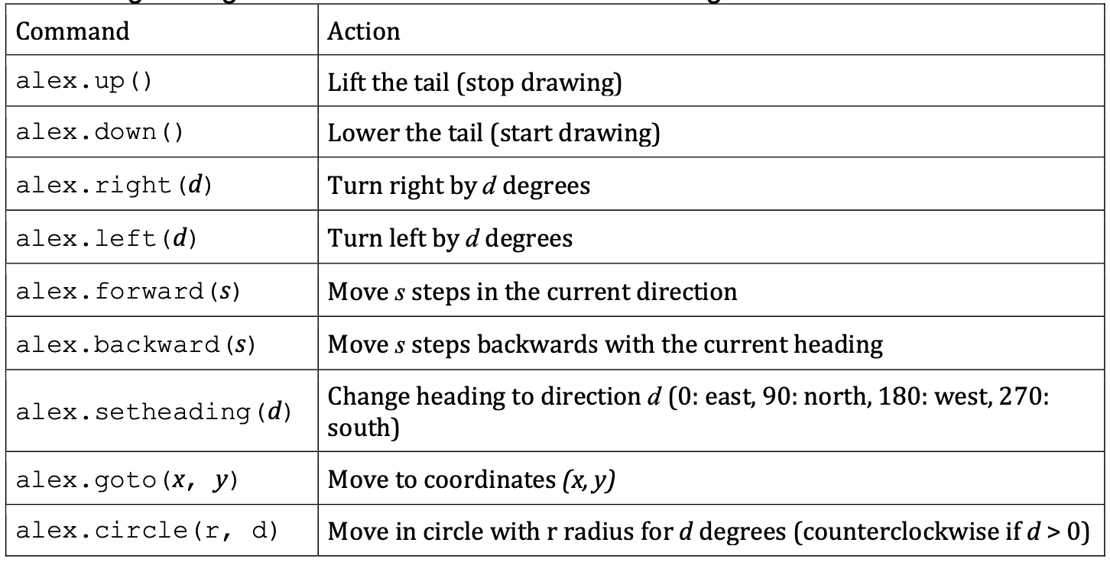
Lab 1: Review of Errors¹
Syntax Errors: occur when your code breaks the syntactic rules of the language (e.g., your code contains unbalanced brackets, identifiers, such as variable or function names, that do not obey the rules)
Added comma missing between arguments
Example: alex.circle(50 180)
Corrected version: alex.circle(50, 180)
Explanation: a syntax rule was broken, more specifically the RULE that function arguments must be separated by commas

Slide 6
Lab 1: Review of Errors²
Semantic Errors: occur when the semantic rules of the language are broken (e.g., calling a function with the wrong argument type or with the wrong number of arguments)
Removed argument
Example: alex.up(5)
Corrected version: alex.up()
Explanation: a semantic rule was broken, i.e., method up() was called with the wrong number of arguments, more specifically up()accepts fewer arguments than were passed to it.

Slide 7
Lab 1: Review of Errors³
Logical Errors: occur when the meaning/semantics of a program is not the intended one (e.g., a mathematical formula is implemented incorrectly, a block of instructions is mis-indented)
Corrected the value of the argument
Example: alex.right(2 * math.pi)
Corrected version: alex.right( 360 )
Explanation: a higher level semantic rule was broken, i.e., function right() assumes that the values passed to it represent angles expressed in degrees (not radians ! ) and was passed a value that represents the value of an angle expressed in radians.

Slide 8
Review of Lecture
Defining and Using functions

Slide 9
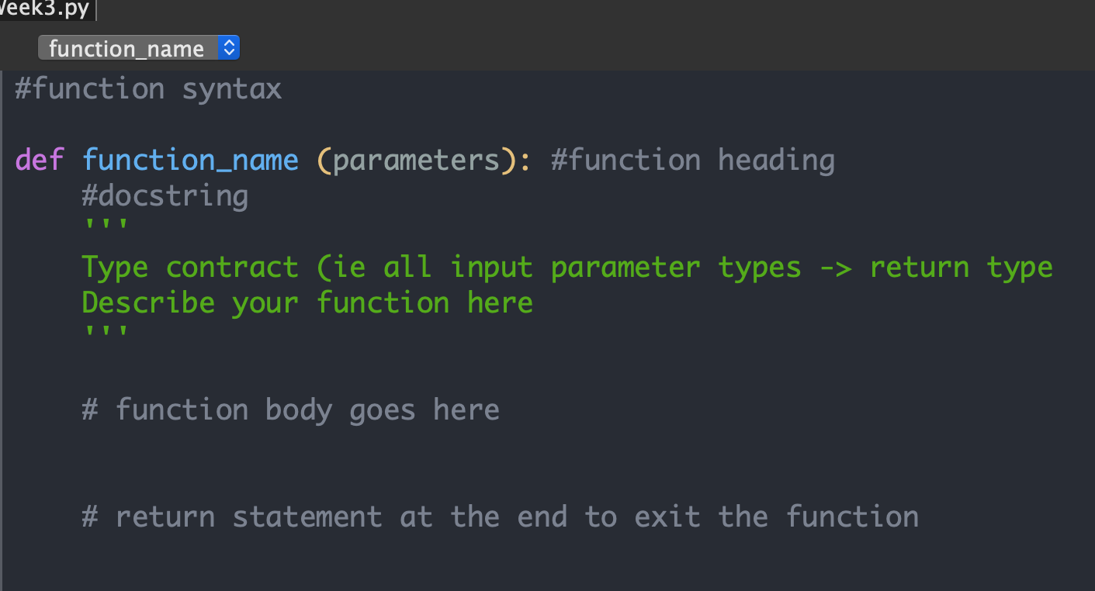
Defining Functions
Function Elements:
Header
Body
Docstring
Statements implementing the purpose (intended semantics) of the function
Practice question:
I implement a function that calculates the area of a rectangle.

Slide 10
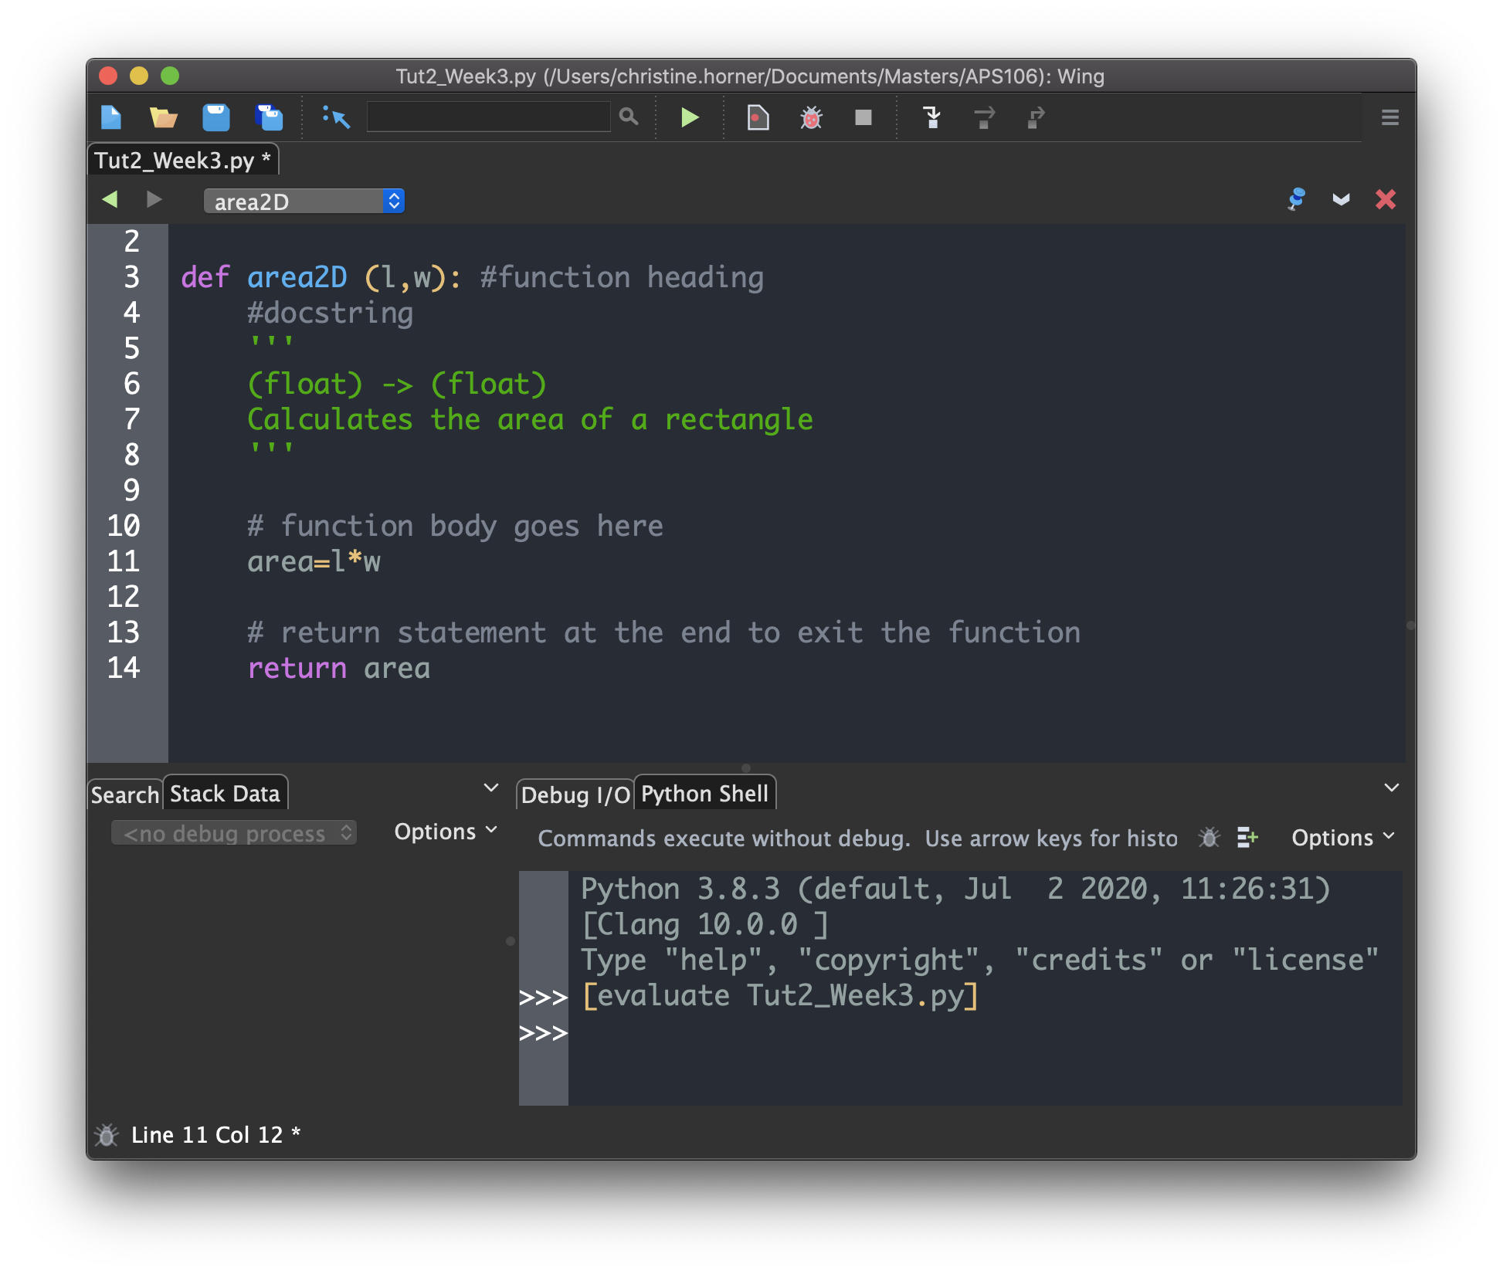
Example of a function
Function Elements:
Header
Body
Docstring
Statements implementing the purpose (intended semantics) of the function
Questions:
What happens when I run this code?
How do/can I use this function ?

Slide 11
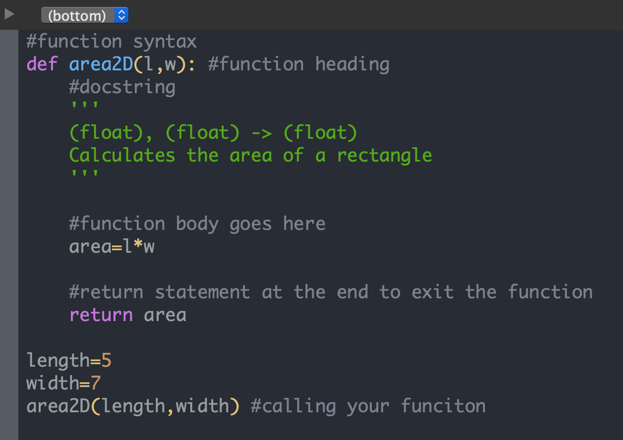
Calling functions
Note: variables length and width are parameters of the area2D function.
Questions:
Q1: Why isn’t the area of the rectangle with length 5 and with 7 displayed in the Python shell?
Q2. How can I display the value returned by the function area2D ?

Slide 12
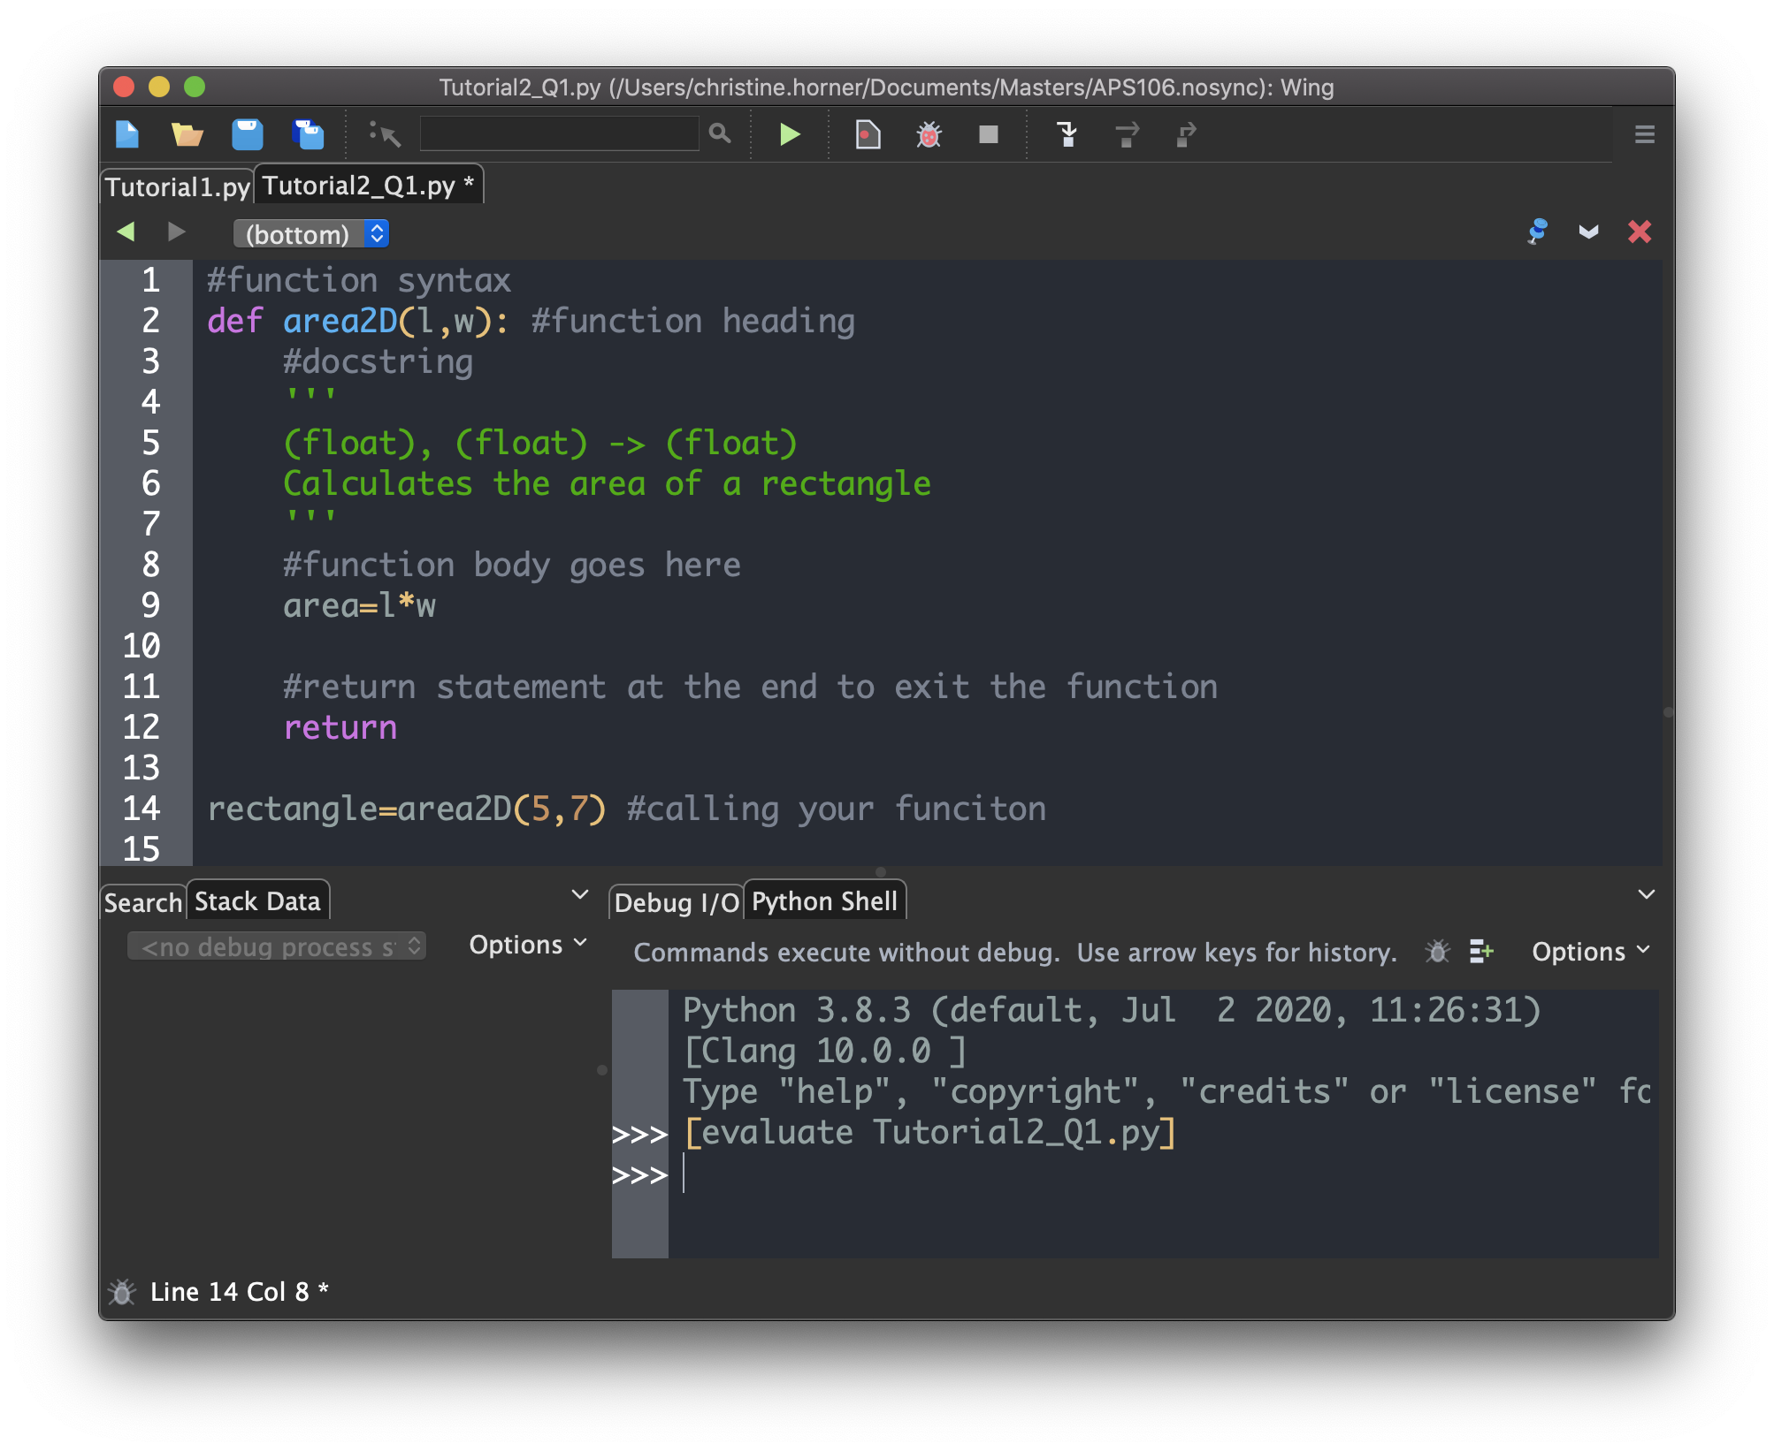

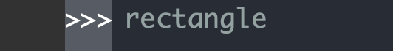
Functions and variables
Q1 Answer: the value returned by the function area2D is "stored" in variable rectangle, but the program does not contain an instruction for displaying the value of variable rectangle.
Try typing the following statements in the python shell to see what happens.
Try adding the following statements to the Python script:
print(rectangle)
rectangle

Slide 13
Review of Lecture
Functions: Tips & Misconceptions

Slide 14
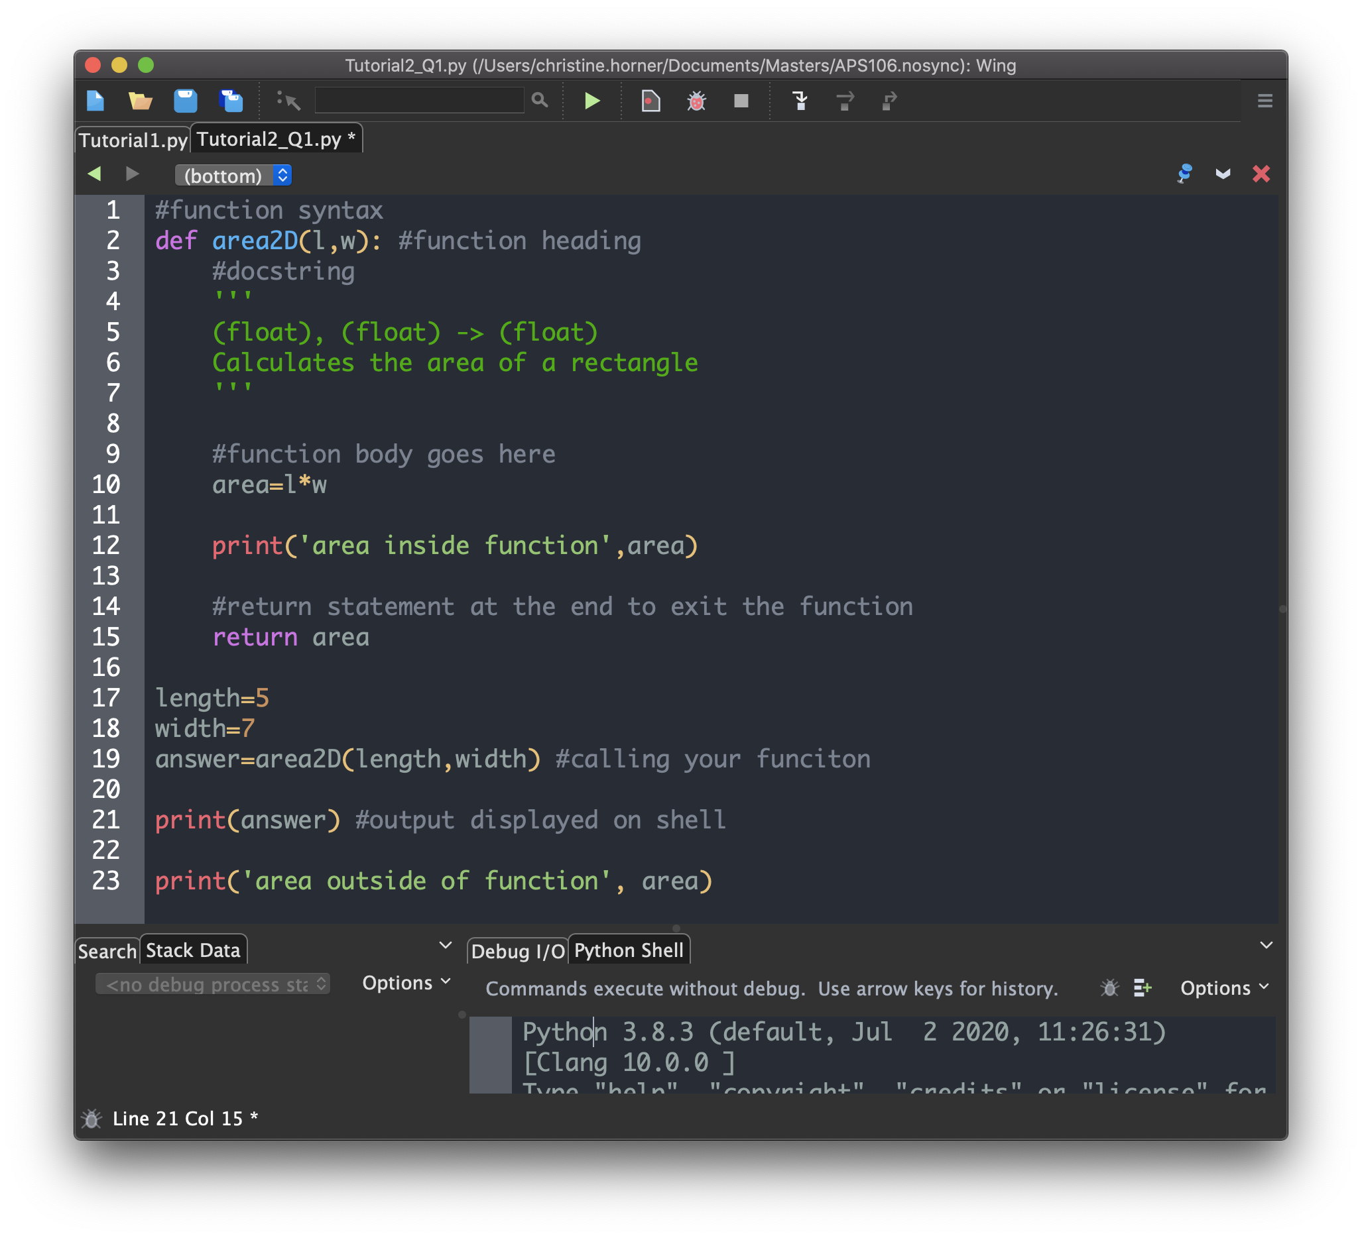
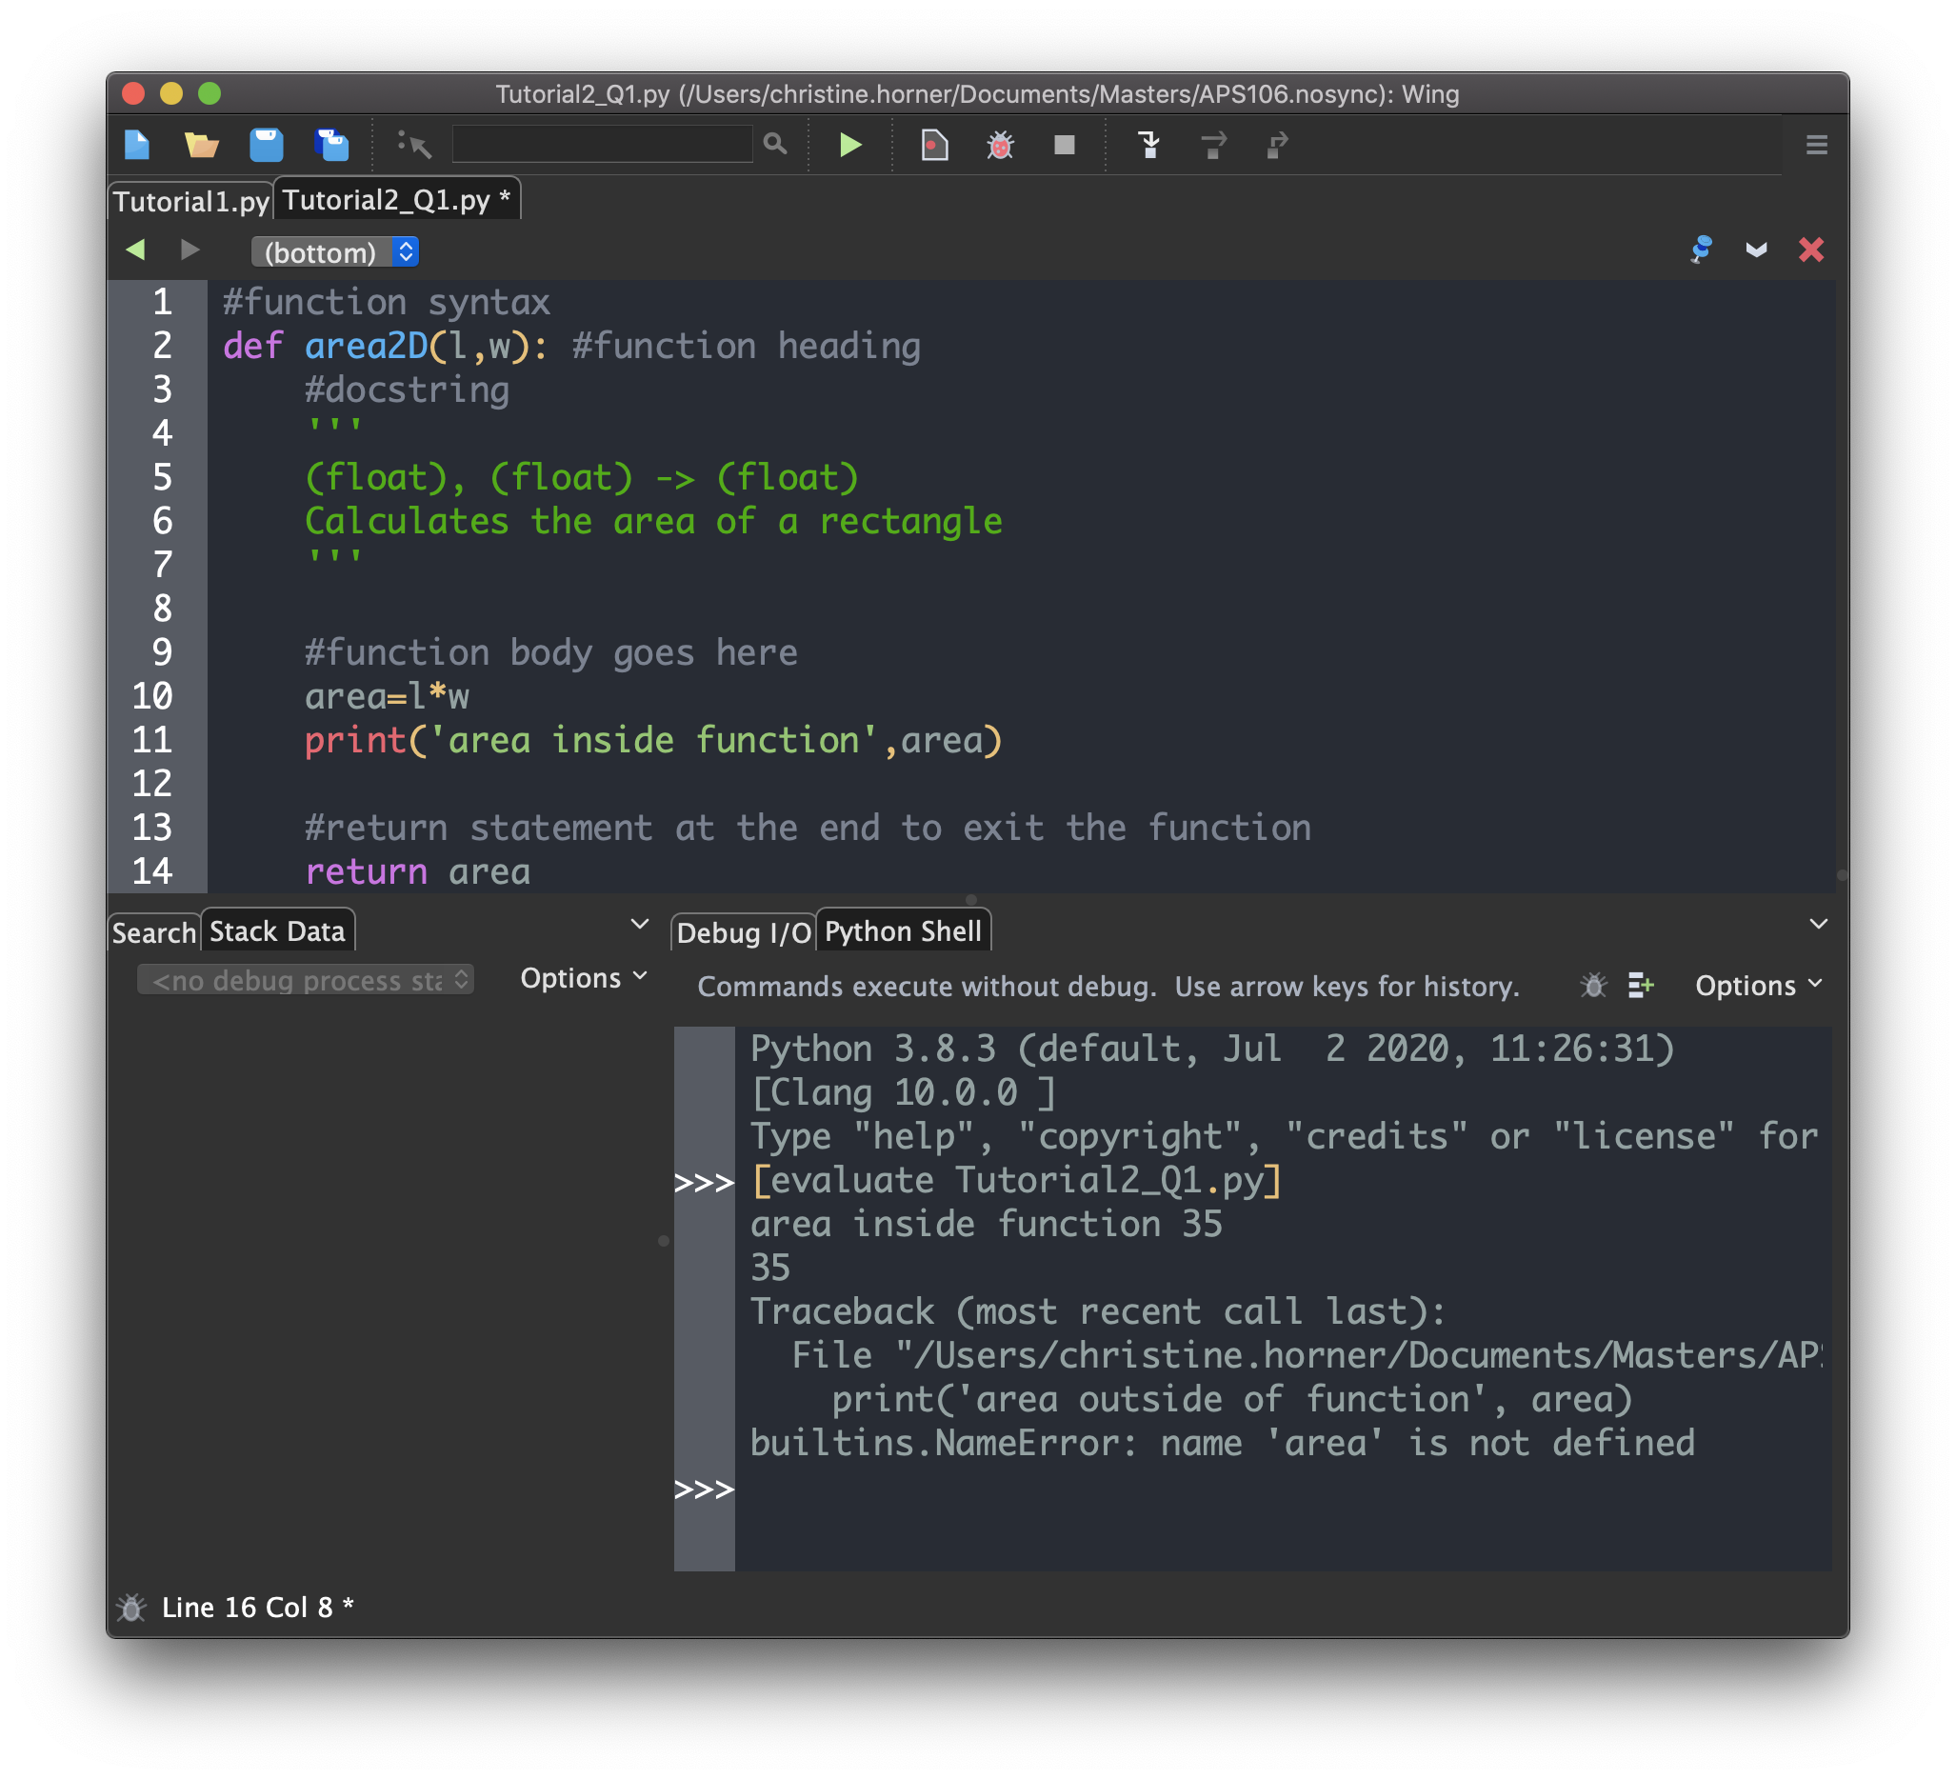
Variable Scope
Variables declared and initialized inside a function are only accessible, aka visible, within the body of the function.
Their values can be accessed from inside the function, e.g., they can be displayed in the shell by passing them as arguments to print()(red case), but cannot be accessed from outside the function, e.g., from the main program body (yellow case)

Slide 15
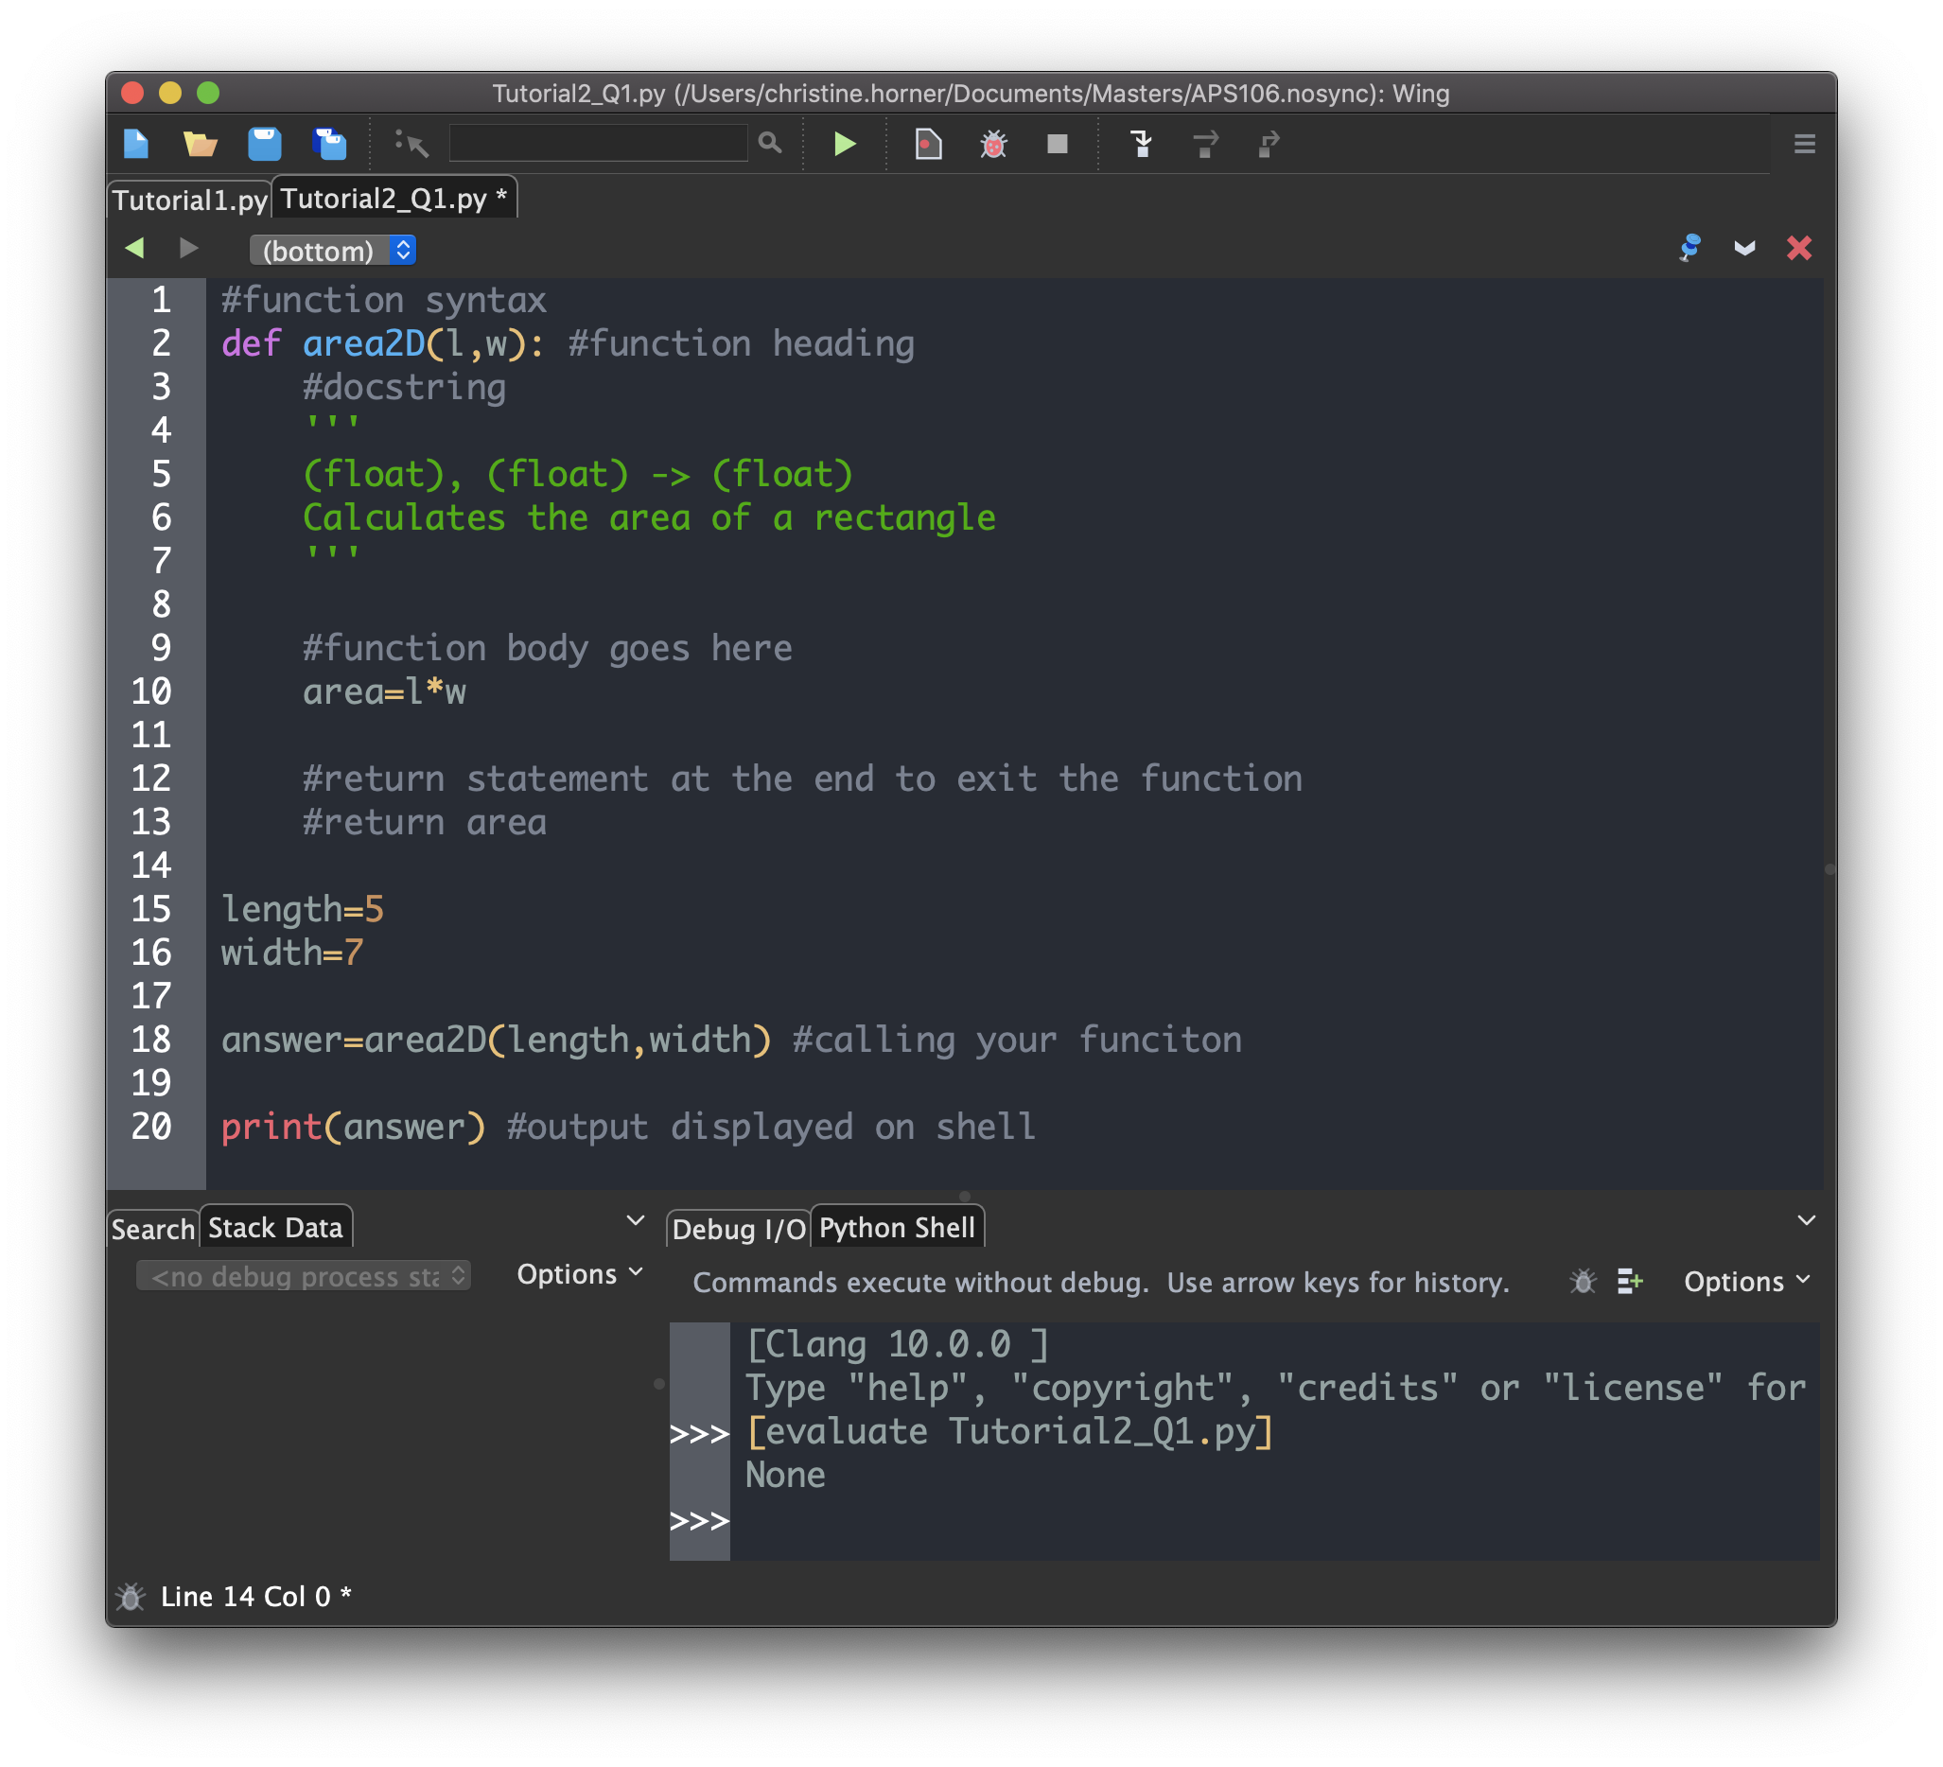
Python Functions Always Return a Value !¹
A Python function whose body does not contain a return statement will return by default the value None.

Slide 16
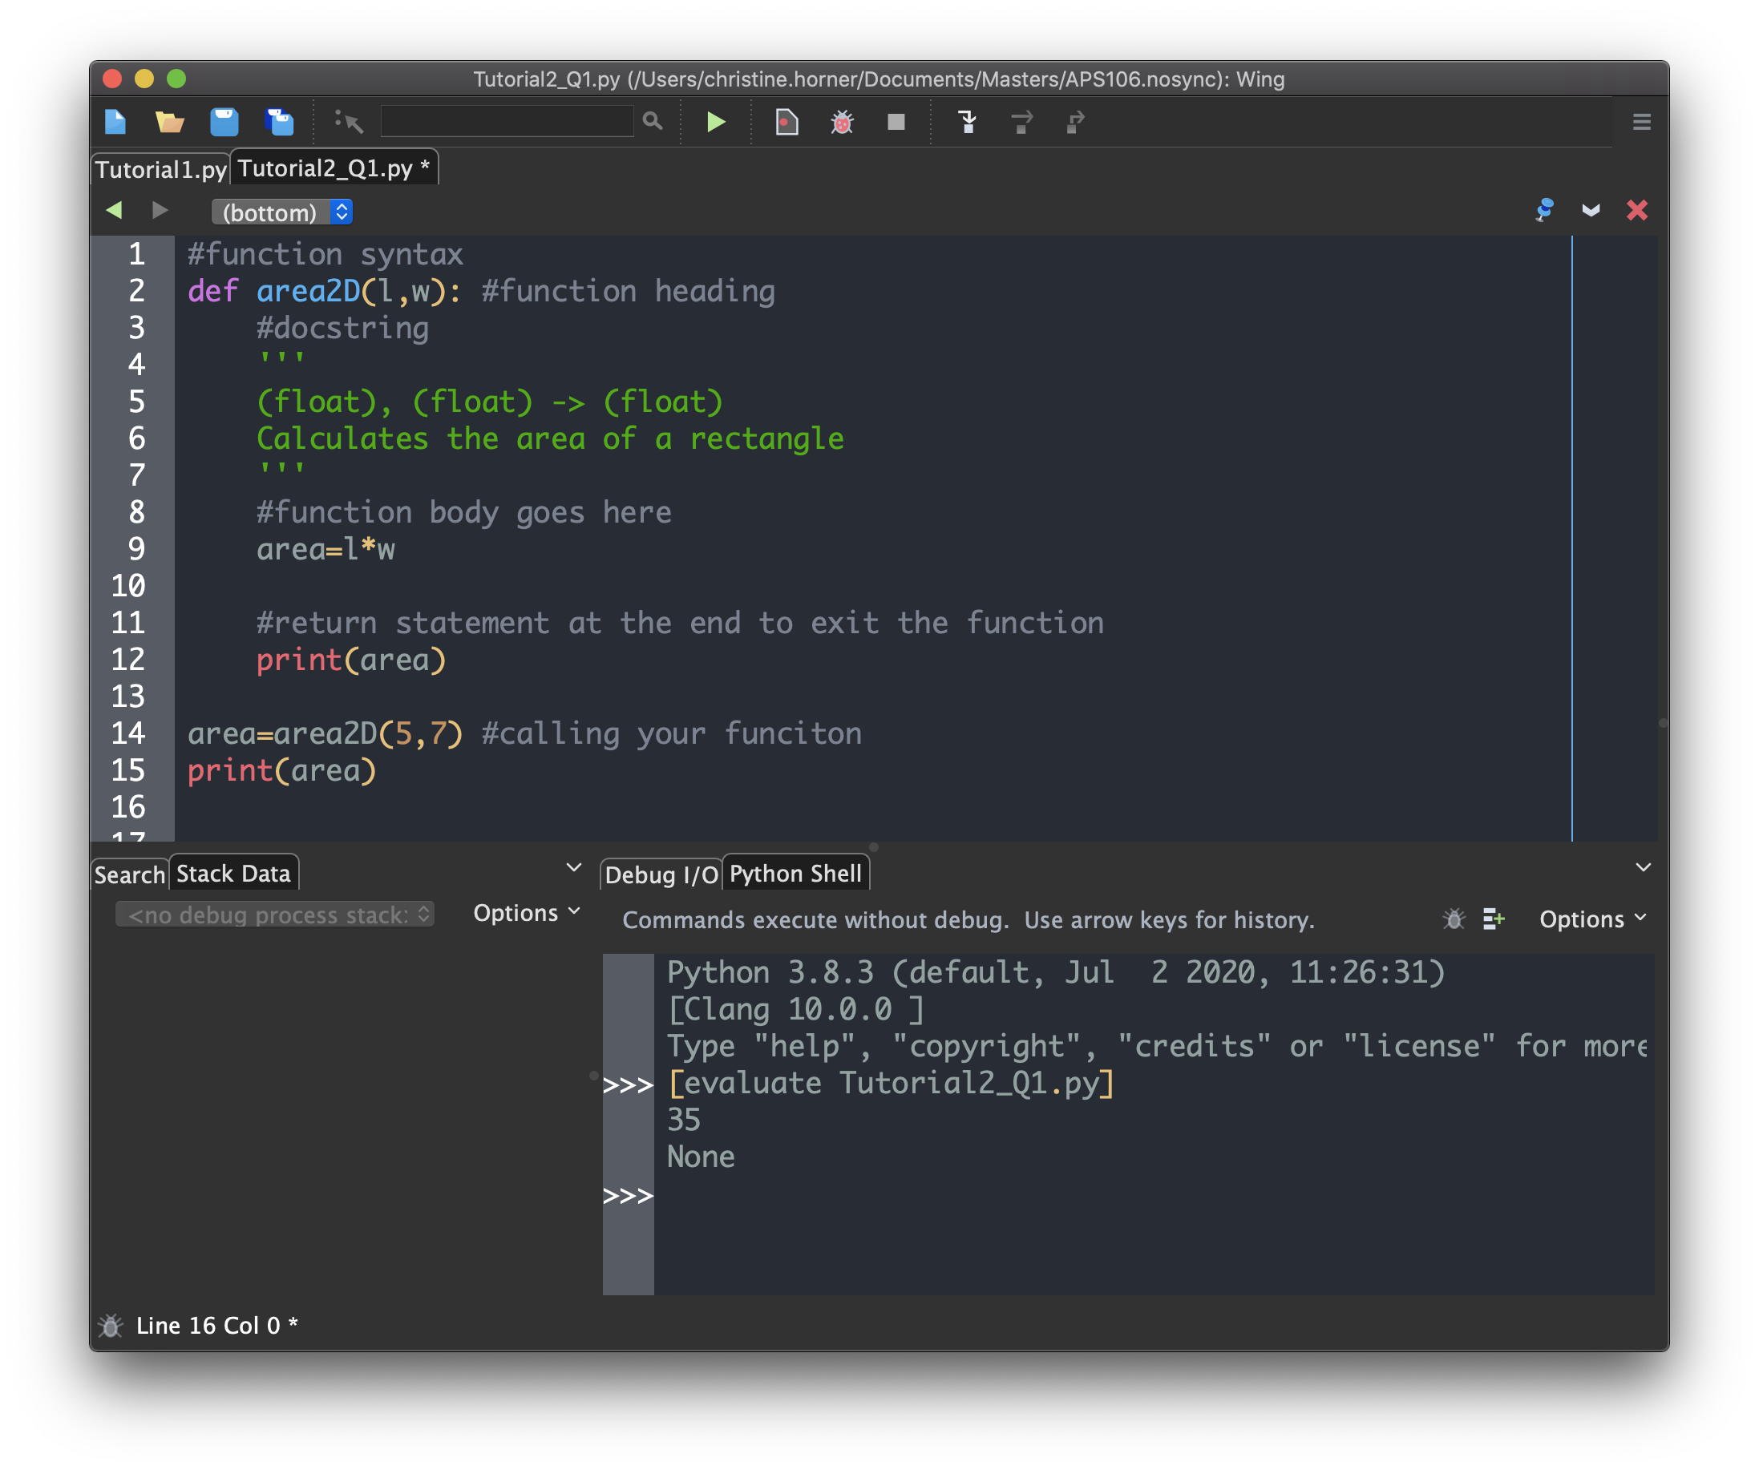
Python Functions Always Return a Value !²
What would be printed in the Python shell ?
If you get this, you understand how functions work ☺
If not, ask more questions !
What would be printed??

Slide 17
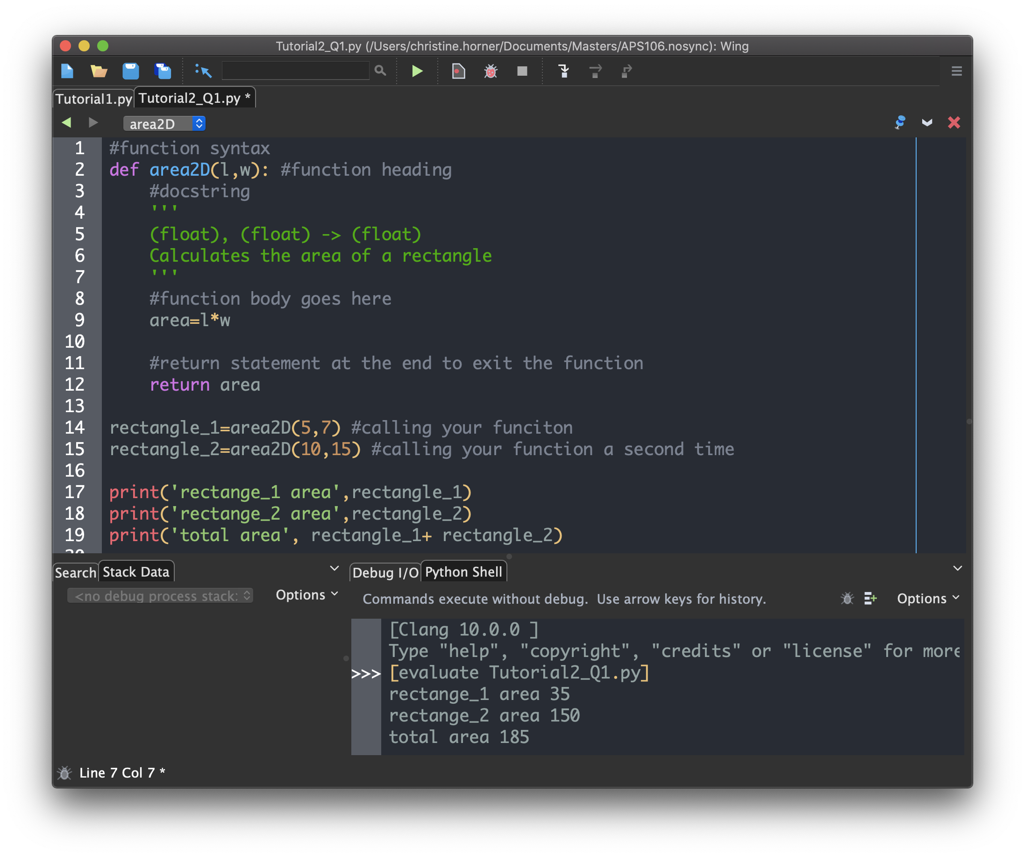
When Do We Need to Use return Statements?
What if you wanted to find the total area of two rectangles ?

Slide 18
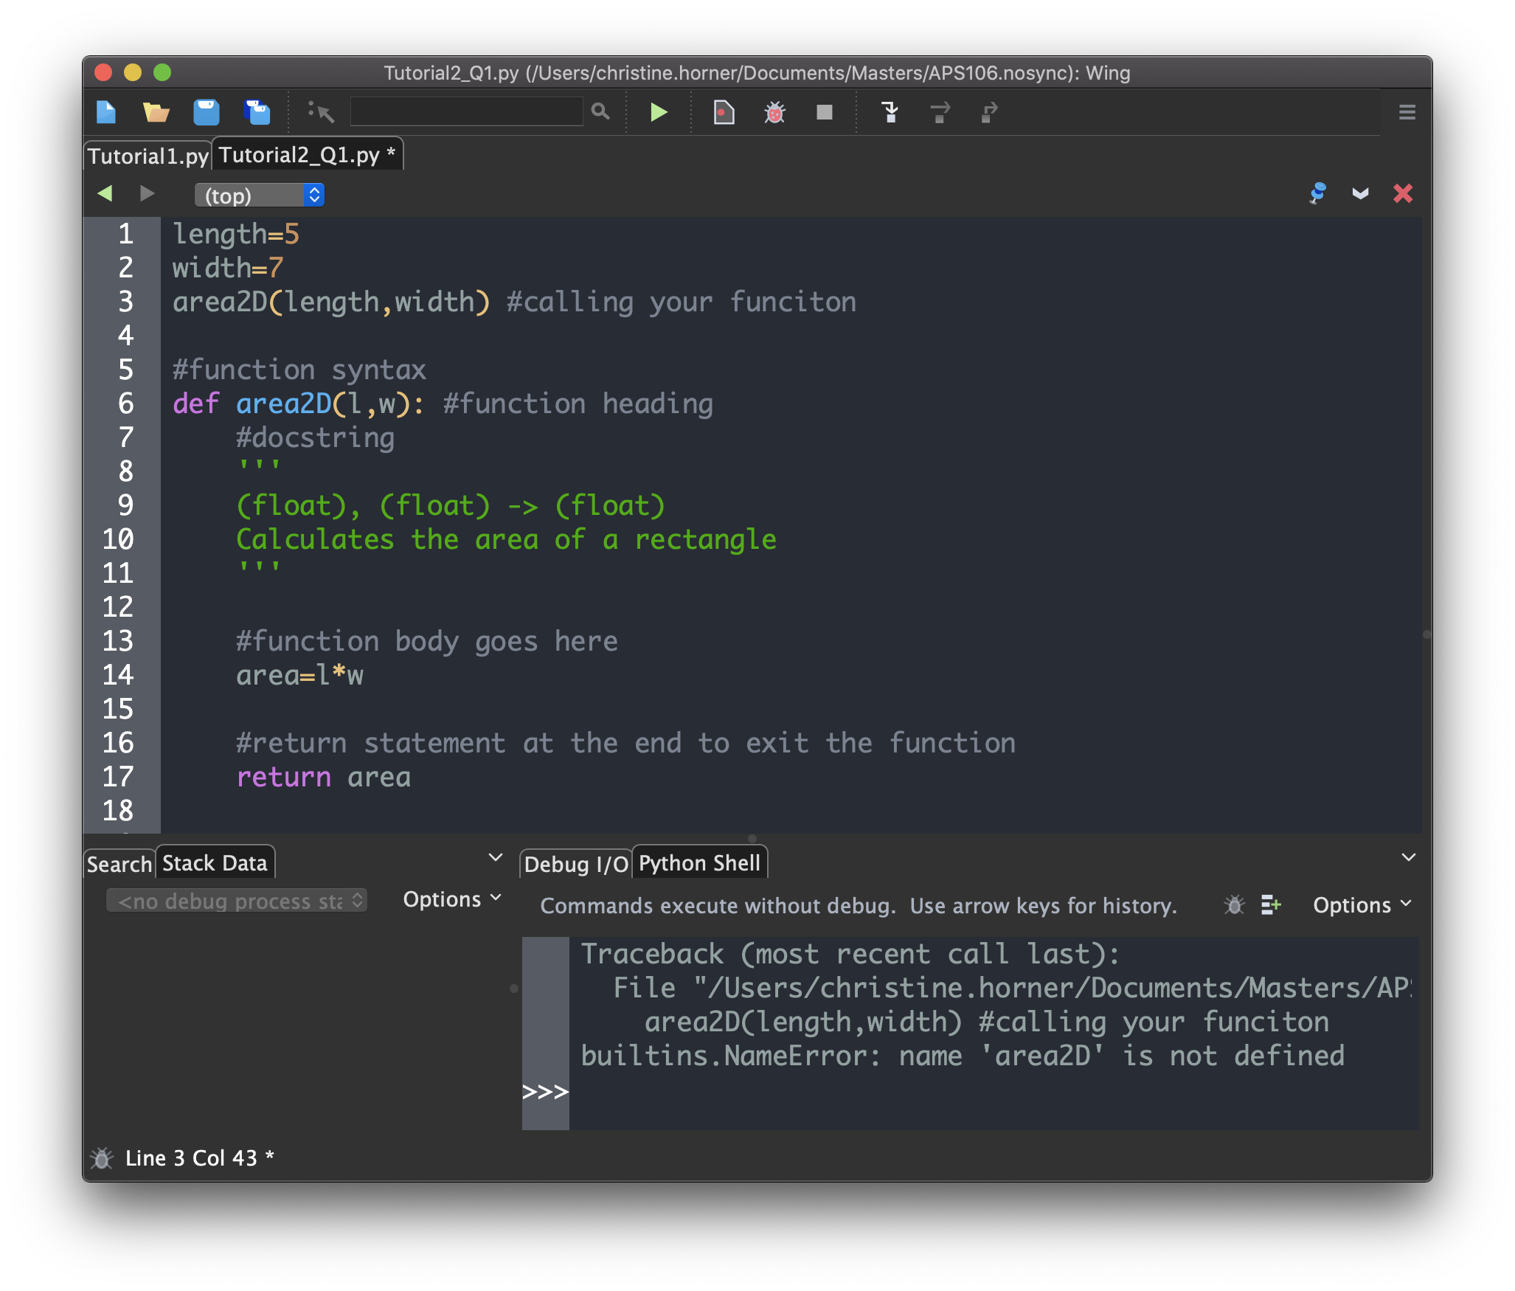
Functions must be defined before being called… or you will get an error !
The error message is telling us that Python has no idea what area2D is.
This is a semantic error caused by the programmer calling a function before it was defined.
⇒ Remember that the Python interpreter runs your code line by line. The statement containing the definition of area2D had not been reached at the time the statement in line 3 was executed.

Slide 19
Review of Lecture
Built-in Functions

Slide 20
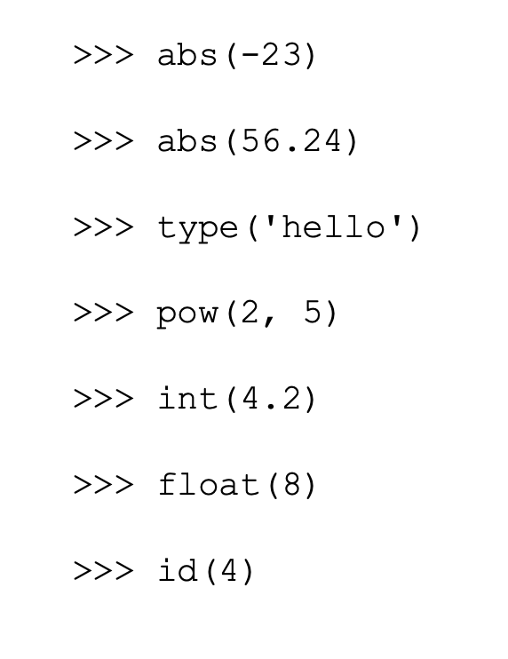
Lecture Content: Built-in Functions!¹
Built-in Functions: functions that come pre-packaged with a Python implementation
Other built in functions can be found here: https://docs.python.org/3.8/library/functions.html
Use help() to look up the documentation for a function, e.g., help(abs)

Slide 21
Lecture Content: Functions²
input( [ prompt ])
If the prompt argument is present, it is written to standard output. The function then reads the line entered by the user in the command line/shell, converts it to a string (stripping a trailing newline), and returns that.
Depending on how we want to process the value entered by the user in our code, we may need to explicitly convert the string returned by input() using typecasting
print( *objects, sep=' ', end='\n', file=sys.stdout, flush=False)
Print objects to the text stream file, separated by sep and followed by end.
sep, end, file, and flush, if present, must be given as keyword arguments.

Slide 22
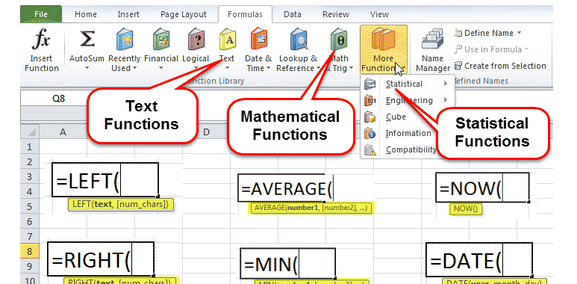
Examples of functions you might have used…
Excel!
Think of your favourite apps on your phone

Slide 23
Review of Lecture
Importing and Using Modules

Slide 24
Python Modules
Various statements, including function and class definitions (which will be introduced in later lectures) can be stored in separate Python files, called modules.
To get access to the functions defined in a module, you need to import the module.
Typical form of importing a module:
import module_name
To access a function within a module:
module_name.function_name

Slide 25
Python's Built-in modules Modules
Built-in modules we use in this course: math and csv.
Example: import math
print(math.abs(-4))
There are many other cool, open source Python libraries, e.g., NumPy, Pandas, scikit-learn, but we won’t cover them in this course and you are not allowed to use them in lab assignments or exams!

Slide 26
Practice Problems

Slide 27


What is printed when this code is run?
ⓘ Start presenting to display the poll results on this slide.
Notes:
📣 This is Slido interaction slide, please don't delete it. ✅ Click on 'Present with Slido' and the poll will launch automatically when you get to this slide.

Slide 28
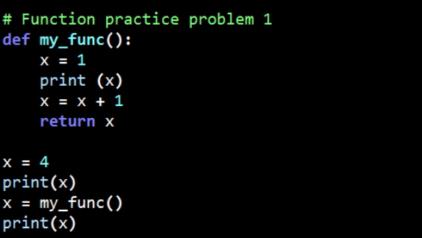
Review Practice Problem 1
What is printed when this code is run?
4,5,5
4,1,4
4,1,2
4,1,1
None of the above

Slide 29

What is the mistake in this code?
ⓘ Start presenting to display the poll results on this slide.
Notes:
📣 This is Slido interaction slide, please don't delete it. ✅ Click on 'Present with Slido' and the poll will launch automatically when you get to this slide.

Slide 30
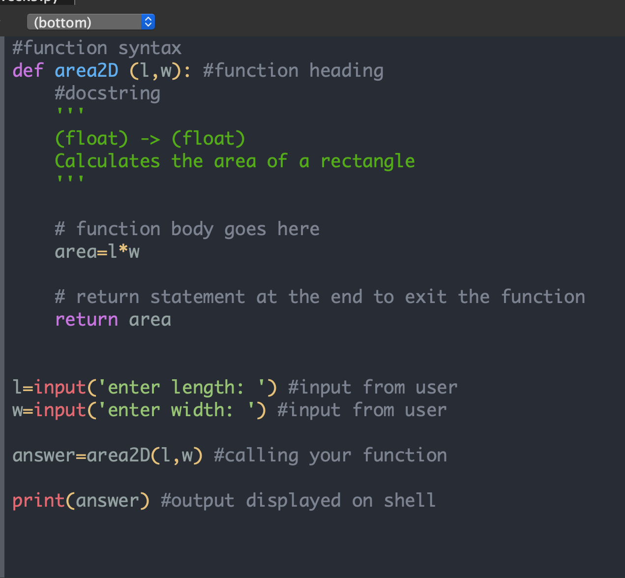
Review Practice Problem 2
What is the mistake in this code?

Slide 31
Coding Problem 1
Write a function to convert an angle expressed in degrees to radians.
HINT: You can import modules. Are there any built-in functions from the math module that can help ?
Things to consider before you start writing your code:
What would be the parameters of your function?
What should the function output?

Slide 32
Coding Problem 2
Write a function with 3 inputs: the minimum speed limit and maximum speed limit of that street, as well as your current speed
Return a number to the user telling them whether they are obeying speed limit rules (number itself), and if not, which speed limit they are breaking (minimum or maximum)
Hint:
There are functions that take in values and return their minimum and maximum

Slide 33
Any questions?
ⓘ Start presenting to display the poll results on this slide.
Notes:
📣 This is Slido interaction slide, please don't delete it. ✅ Click on 'Present with Slido' and the poll will launch automatically when you get to this slide.

